Slide 1

Micro-Partitions and Clustering

Slide 2
Agenda
How data is stored in micro partitions
Metadata of micro partitions
Benefits of micro partitions
Clustering (Cluster keys)
Defining Cluster keys
How to choose Cluster keys

Slide 3
Micro partitions
Snowflake has implemented a powerful and unique form of partitioning, called micro-partitioning.
Micro-partitioning is automatically performed on all Snowflake tables.
Tables are transparently partitioned using the ordering of the data as it is inserted/loaded.
Micro-partitions are small in size (50 to 500 MB).
Data is compressed in micro partitions
Snowflake automatically determines the most efficient compression algorithm for the columns in each micro-partition.

Slide 4
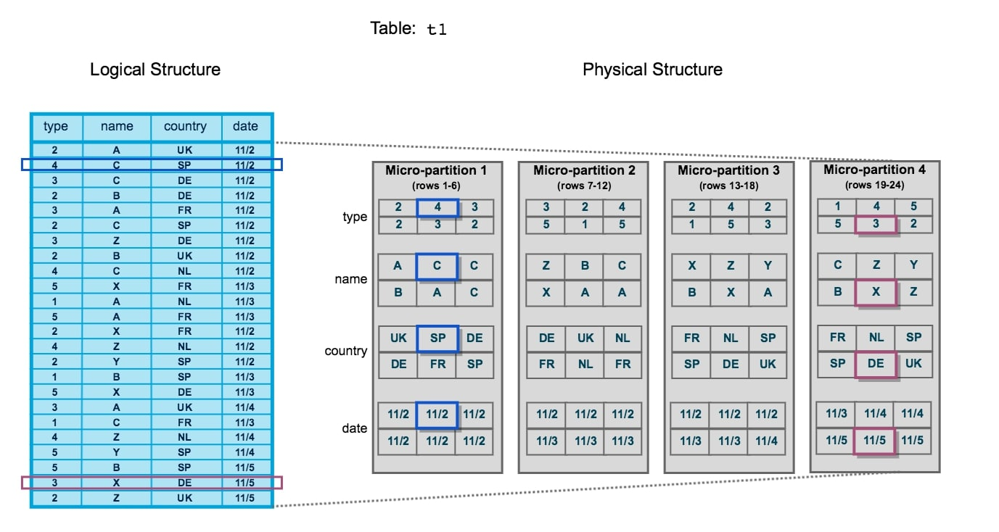
Eg: Observe how the blue coloured and magenta coloured data stored

Slide 5
Metadata of Micro partitions
Metadata is also maintained by Snowflake which Includes…
the number of distinct values for each field
the range of values for each field
Other useful information to improve performance.
Metadata is a key part of the Snowflake architecture as it allows queries to determine whether or not the data inside a micro-partition should be queried.
This way, when a query is executed, it does not need to scan the entire dataset but instead only queries the micro-partitions that hold relevant data.
This process is known as query pruning, as the data is pruned before the query itself is executed.

Slide 6
SELECT type, country
FROM MY_TABLE
WHERE name = "Y“;
The only micro-partitions that match this criterion are micro-partitions 3 and 4. The query pruning has reduced our total dataset to just these two partitions
And only the [type] and [country] fields are required in the query output, any part of micro-partitions that do not contain data for these columns would also be pruned.
i.e. When the micro-partitions themselves are queried, only the required columns are queried

Slide 7
Benefits of Micro partitioning
In contrast to traditional static partitioning, Snowflake micro-partitions are derived automatically; they don’t need to be explicitly defined up-front or maintained by users.
Micro-partitions are small in size (50 to 500 MB), which enables extremely efficient DML and fine-grained pruning for faster queries.
Columns are stored independently within micro-partitions, often referred to as columnar storage. This enables efficient scanning of individual columns; only the columns referenced by a query are scanned.
Columns are also compressed individually within micro-partitions, this optimizes the storage cost.

Slide 8
Clustering
Clustering is a key factor in query performance, It reduces the scanning of micro partitions.
A clustering key is a subset of columns in a table that are explicitly designated to co-locate the data in the table in the micro-partitions.
Initially the data will be stored in micro partitions in the order of inserting records, then will be realigned based on the cluster keys.
We have to choose proper Cluster keys.
We can define cluster keys on multiple columns as well.
We can modify the cluster keys based on our requirements, this is called as re-clustering.
Re-clustering consumes credits, number of credits consumed depends on the size of the table.

Slide 9
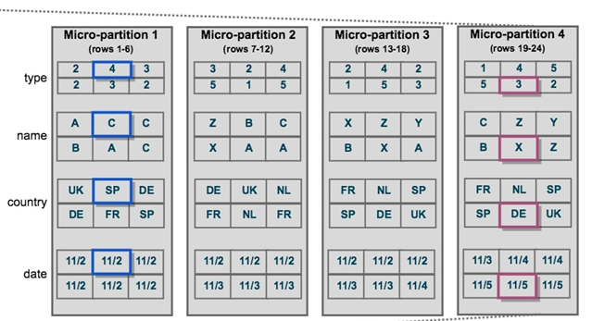
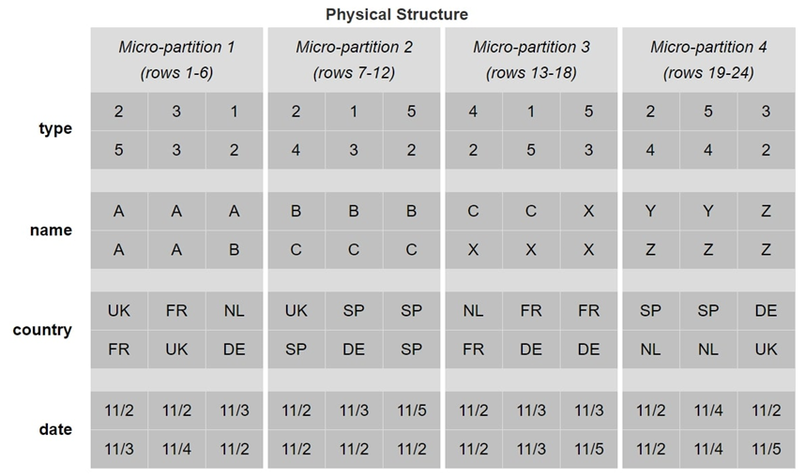
Clustering Keys :
In this second example, lets say we clustered our dataset based on the [Name] field, as this was the frequently used key field used in our queries in WHERE CLAUSE / JOIN

Slide 10
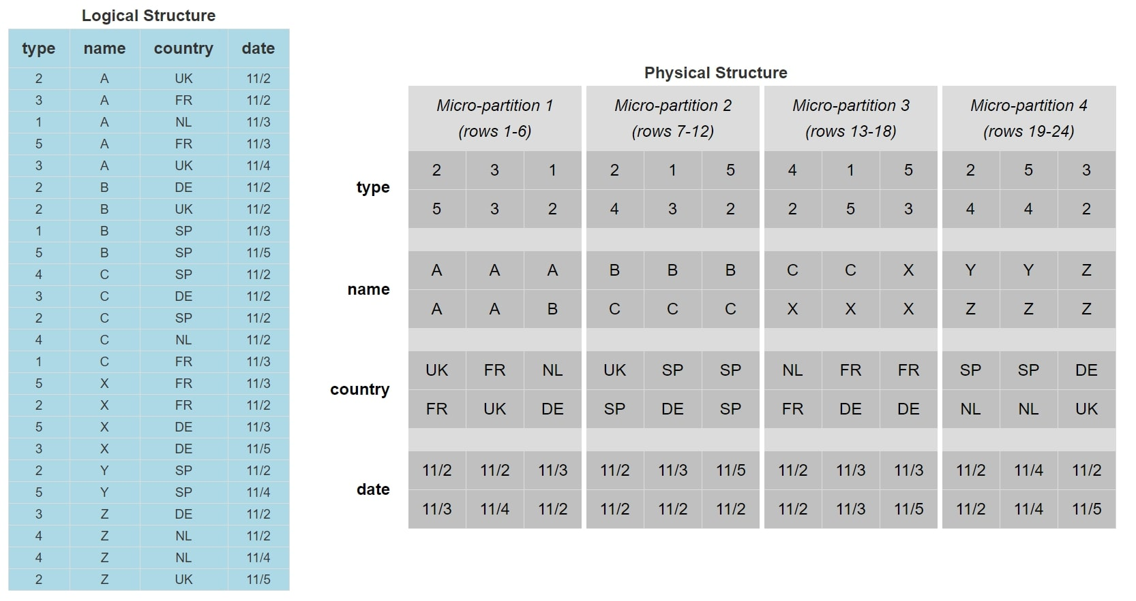
The data is now stored and ordered based on the value of the [name] field.
The micro-partition 4 is now the only micro-partition that contains [name] values of Y.
When we execute our earlier query now, the query pruning will reduce our target data down to just micro-partition 4, which means our query has less data to interpret and thus will perform more efficiently.

Slide 11
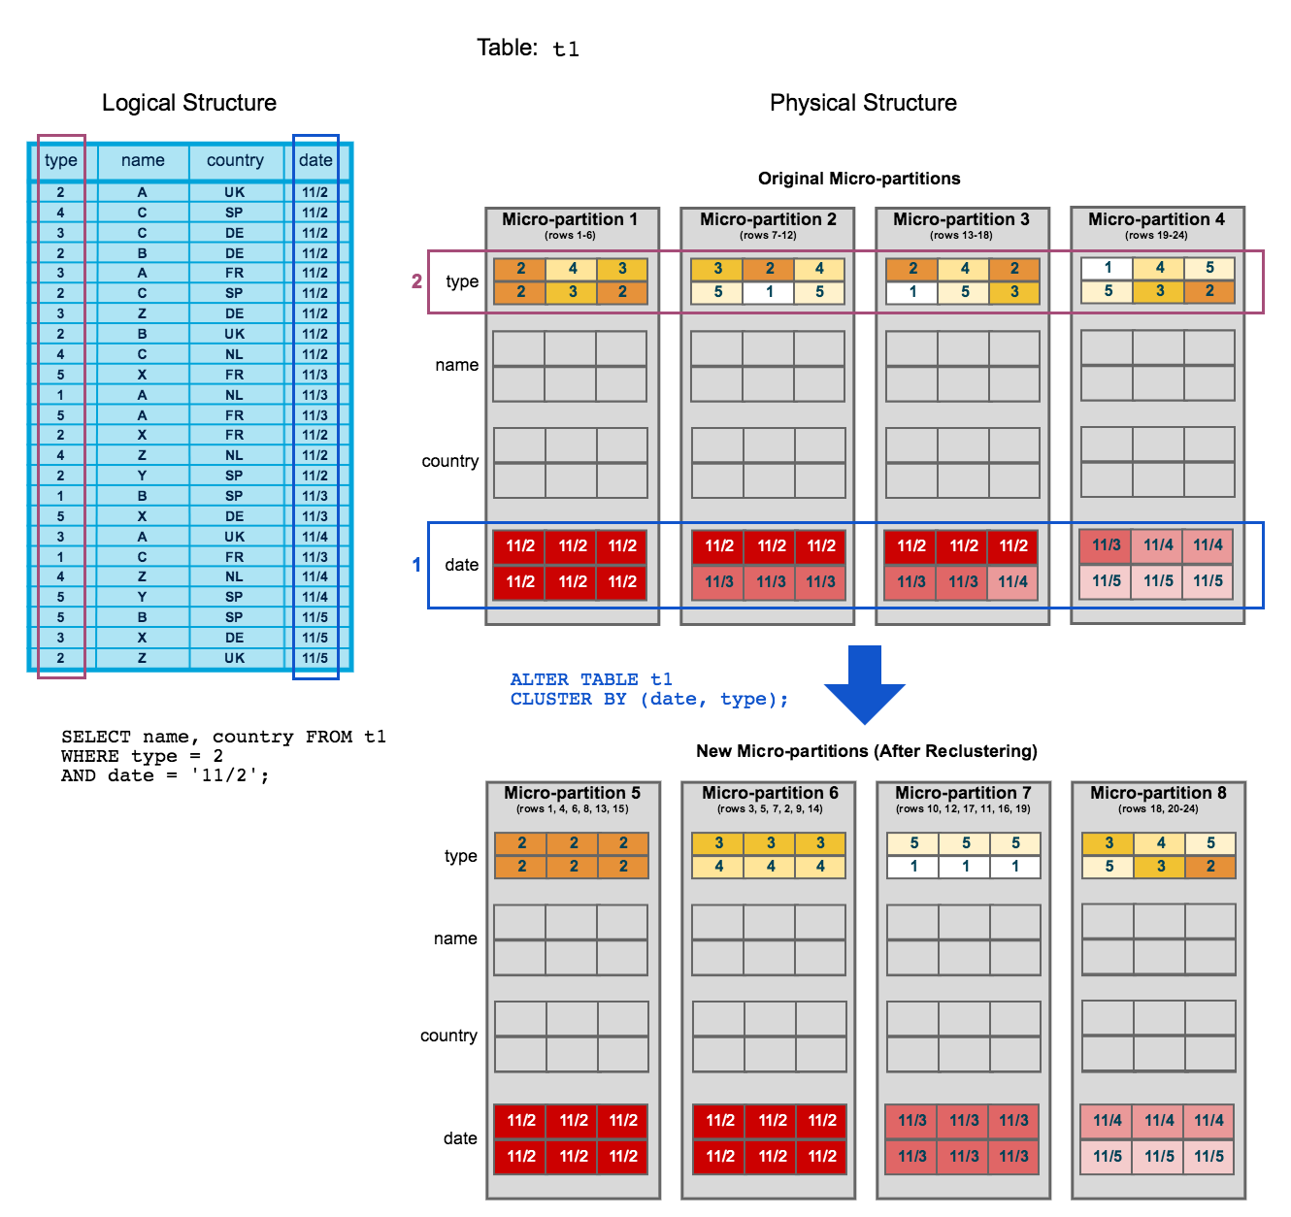
Or if we see type and date column getting frequently in where clause.. Then ALTER table to include both as cluster keys

Slide 12
Defining Cluster keys
Defining Cluster keys on a new table:
CREATE TABLE MY_TABLE
(
type number,
name string,
country string,
date date,
)
CLUSTER BY (name);
Modifying Cluster keys on existing table:
ALTER TABLE MY_TABLE CLUSTER BY (name, date);

Slide 13
Choosing Cluster Keys
Define cluster keys on
Columns frequently used in Filter conditions (Where clause)
Columns using as Join keys
Frequently used functions or expressions
Like YEAR(date), SUBSTRING(med_cd,1,6)
Snowflake recommends
Define cluster keys on large tables and don’t on small tables.
Don’t define cluster keys on more than 4 columns.

Slide 14
Thank You

